Slide 1

The Data Science Accelerator and AI applications
May 2019
Sevgui Erman, Christie Sambell, Stan Hatko Enterprise Statistics Division

Slide 2
Outline
The Data Science Accelerator (DSA): goals and mission
The DSA
Applications
Data types
High level steps from Inception to Production
Freight Trucking Statistics
Communication Effort
Appendix:
List of current projects
Machine Learning for Trucking Commodity Origin and Destination Survey
2

Slide 3
DATA SCIENCE ACCELERATOR (DSA)
Mission statement:
Build Data Science capacity by solving concrete problems
Goals
Build solid expertise in implementation of leading-edge AI/ML solutions
Deliver practical results enabling clients to move forward confidently with big/unstructured data
“Get things done fast”
Build and share data science capacity
Fully leverage partner expertise (e.g., subject matter, methodology, IT, etc.)
3

Slide 4
THE DSA …
Is staffed by a multidisciplinary team of data scientists that are experts in the latest open source, coding, hardware and Cloud services techniques to tackle projects employing natural language processing (NLP), image processing, neural networks, blockchain, robotic process automation, etc…
Uses the latest Lean, MVP, Agile, Startup management methodologies
Catalyses culture change: delivery of small wins; concrete results to build confidence and trust; fail early + pivot fast.
Collaborates with other STC Fields and other GoC Departments.
4

Slide 5
HYBRID HUB AND SPOKE MODEL
A start-up that supports other start-ups
Accelerator of…
…Results: from light supervision/technical support to full delivery
…Expertise: actively promotes the spreading of data science skills across StatCan
Develops solutions in Mode2, transitions them to Mode1
E.g.: retail scanner data in production - requires active participation from all stakeholders; inherently capacity building and user centric; holistic horizontal approach.
DSA
5

Slide 6
TYPES OF APPLICATIONS
27
4
Natural Language Processing
Image classification
Text classification, address parsing, owners name parsing, clustering, event detection, text summarization, sentiment analysis, record linkage
4
1
Robotic Process Automation
Numerical data
8
2
Web information retrieval &
API use
Modelling of livestock movements
4
6
PDF extraction
Other (IT infrastructure, blockchain, voice systems)
6

Slide 7
TYPES OF DATA
Retail scanner data
Transactional transportation electronic files
Housing program - property owners data
Enterprise financial reporting (Web, Factiva DNA, Sedar)
Financial statements
News articles data bases (Factiva DNA, NewsDesk)
Web scraped commodities data
Survey comments
International trade transactions
Agriculture satellite images – crop, greenhouses, solar panels
Construction satellite images
StatCan disseminated data
7

Slide 8
High level steps from Inception to Production
Proof of Concept
Transition to Production
Production
Scaling up Model
to Prod
Idea/ Problem
PoC Model
Review
Review
Production
Pilot/ Parallel
8

Slide 9
Freight Trucking Statistical Program (FTS) Idea/Problem
The Freight Trucking Statistical Program (FTS) came to us with a problem
They wanted to modernize from a survey first model to a administrative data first model.
They currently have 5 companies that submit their shipping documents electronically and over a thousand that are surveyed but they want to get as many companies submitting their shipping documents electronically as possible. Their aim is a 100 companies the first year.
Their current system for classifying the description of the transported products to Standard Classification of Transported Goods (SCTG) is no longer being supported
Current system requires a significant amount of manually fixing the codes.
They needed a new method to classify an increased volume of products more efficiently and with greater accuracy.
9

Slide 10
Freight Trucking Statistical Program (FTS) Mode 2- Proof of Concept
Our objective for this project: build a model that given a product description, outputs an SCTG code. We had the historical data for 5 company so we used the data from one company in the Proof of Concept (about 150,000 records per month). We split the data for K-fold cross validation. We tried using couple of different methods: Support Vector Machines with Linear Kernels and XGBoost with linear Booster. We were in constant discussion with the client to get more labelled data from them and re-running the model and hyperparameter tuning until we achieved the desired accuracy.
Train Model
Model Validation
Data Wrangling
Acquire more labelled data
Final PoC model using XGBoost with accuracy consistently around 91%
10

Slide 11
Freight Trucking Statistical Program (FTS) Mode 1 -Transition to Production
Once we achieved the upper bound of accuracy from the Proof of Concept model we then sat down with all players at the table (DSA, client, methodology and IT) to decide whether to transition this project to Production.
For FTS we decided to do a 2 pronged approach:
A scale up of the model to include the other 4 companies that we already have historical data for and then the approximately 100 new companies
a pilot project to test integrating the PoC model into corporate tools
We are currently managing both of these concurrently.
11

Slide 12
Freight Trucking Statistical Program (FTS) Mode 1-Transition to Production (Pilot)
The pilot requires us to work with many different teams at Statistics Canada. This pilot helps them plan for and adapt to the changes that are coming.
Challenges:
Most of the teams we are working with are new to Machine Learning so we have to do a lot of evangelising, teaching and reassuring as we go
We are integrating this model into Statistics Canada wide tools, some of which are still under development.
Another important aspect of the pilot is to test out the Quality Assurance framework that Methodology developed. A small sample of the product descriptions are taken (~1200 across 100 strata) and given to the clients to manually code. The results of the manual coding are then compared with the results of the ML coding for each of the product descriptions. Quality metrics are calculated from this comparison.
12

Slide 13
Freight Trucking Statistical Program (FTS) Production
The final phase is Production. Production will look very different for every project. For FTS we still need to plan who is responsible for monitoring the quality of the models’ outputs and retraining the models when necessary.
The Quality Assurance Framework will continued to be used to monitor the quality of the results from the model over time and help decide when the model needs to be retrained.
Model Deployment
Management & governance
Quality Assurance
Production
Model is Production ready
Model requires retraining
13

Slide 14
Communication Effort
DSA GitHub page https://github.com/dsa-statcan
Image processing interdepartmental CoP
Contact: Nick Denis nicholas.denis2@canada.ca
External
Internal
Applied ML CoP: Text classification and Natural Language Processing
(Internal but is opened to external participants)
Confluence page: https://confluence.statcan.ca/pages/viewpage.action?pageId=453618258
Contact: Monica Pickard monica.pickard@canada.ca
14

Slide 15



THANK YOU!
For more information, please visit
www.statcan.gc.ca
#StatCan100
15

Slide 16
Appendix A: List of current projects
Canadian Export Reporting System text classification
Agriculture solar panels detection using satellite images
News business sentiment indicators
Transfer Learning for scanner data NAPCS classification
Agriculture livestock traceability movements prediction
Survey respondent comments classification – Multiple Retail, Service Industry, Manufacturing and Energy Surveys
Data integration into voice systems
Manufacturing product write-ins classification
Survey comments classification – Survey of Sexual Misconducts in the Canadian Armed Forces
Web recommendation system
Data mining for large enterprises – financial variables – SEDAR
Transfer Learning for trucking commodity data to SCTG classification
NLP for economic events detection
International Trade Error Detection and Imputation Scale up and Parallel
Agriculture crop yield estimates using satellite images
16

Slide 17
Appendix B: Machine Learning for Trucking Commodity Origin and Destination Survey
Technical presentation on the ML project for the Freight Trucking Statistical Program (FTS)
As part of the redesign the Trucking Commodity Origin and Destination Survey (TCOD) became the Freight Trucking Statistical Program (FTS)
17

Slide 18
Machine Learning for Trucking Commodity Origin and Destination Survey
January 2019
Stan Hatko
Enterprise Statistics Division
Partners: Larissa Ngassa, Vincent Dube, Shelly Tessier, Nathalie Larocque, Elaine Henry, Yves Gilbert, Peggy Moffat, Aya Hagag, Marie-Claude Mathieu, Isaac Ross, Kerry Schneider, Sylvie Cyr, Herbert Nkwimi Tchahou, Serge Godbout

Slide 19
Trucking Commodity Origin-Destination (TCOD) Survey
Survey by Energy, Environment, and Transportation Statistics Division (EETSD), that obtains data on origin and destination of products transported by trucking companies.
Multiple methods of collection used, including electronic file transfer of all products (for a few companies) and samples of products collected by interviewers (for most companies).
This survey is undergoing a redesign, with electronic files soon to be received from thousands of companies and new methodologies thought.

Slide 20
Trucking Commodity Origin-Destination (TCOD) Survey
The electronic files contain information on the origin and destination of the product, a text product description, and some additional information.
Objective of this project: build a model that given a product description, outputs an SCTG (Standard Classification of Transported Goods) code.
Currently the SCTG classification is done by a system called ACTR (Automated Coding by Text Recognition) and extensive manual corrections. The redesign provides an opportunity to automate better the coding process.

Slide 21
Product Text Descriptions
The trucking company provides short text descriptions of each product.
Examples of product descriptions:
3 CTN Hangers
SUB 2 Cabinet Only
Beverages Container
ITEM 220 Shower Door
SKID CNT 12 PCS WATER WELL ACC
Skid Pet Supplies
Glowing Sticks
FRESH OR FRZN CHICKEN
Box of General Parts
Some descriptions give more detail than others.

Slide 22
Standard Classification of Transported Goods
Hierarchical classification system for products (similar to NAPCS), with 5 digits.
Example SCTG code:
34 – Machinery
342 - Turbines, boilers, nuclear reactors, and non-electric engines and motors except internal-combustion piston engines
3421 – Turbines
34212 - Turbo-jets, turbo-propellers, and other gas turbines, including aircraft turbines
Overall there are 512 SCTG codes at the deepest level, and 982 at all levels.

Slide 23
Data Available
Labelled data is available from five companies, as well as a reference file from standards containing some examples (including some unusual and unique terms).
To start the project, we looked at data from one company and the reference file.
Data available per file:
Reference file: 34795 entries
Company dataset: 142949 entries
Files contain text descriptions and associated SCTG code.
A pseudo-category XXXXX is used for products for which no level of SCTG code can be associated.

Slide 24
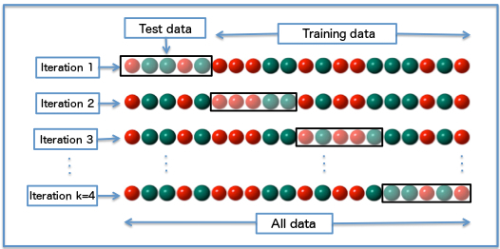
K-Fold Cross Validation
Provides a way to generate predictions for all entries in the company dataset, by having each entry in exactly one testing set for evaluation (in all other splits, in training set to build model).
The k-fold splits are done for the company data, with the data from the reference file always appended to the training set.

Slide 25
Bag of Words Model
In the bag of words model, we look at the
presence of a word anywhere in the document.
For example, in the string “super chocolate milk” the words “super”, “chocolate”, and “milk” are present, and these will be used as features in the model.
The context of the words is ignored.
A matrix (called the document term matrix) is created, with the rows being the documents and the columns the words. Each entry is an indicator if the word appears in the corresponding document (count can be used instead of binary indicator, produces very similar results here).

Slide 26
Character n-grams
An extension to the bag of words model, where
instead of looking at the presence of words we look
at the presence of character substrings of length n.
For example, for “super chocolate milk”, n-grams of length between 3 and 6 include:
“super”
“sup”
“choco”
“per ch”
“ate mi”
“milk”
Provide a nice way to handle multiple issues, including pairs of words, plural forms, truncated words, etc.

Slide 27
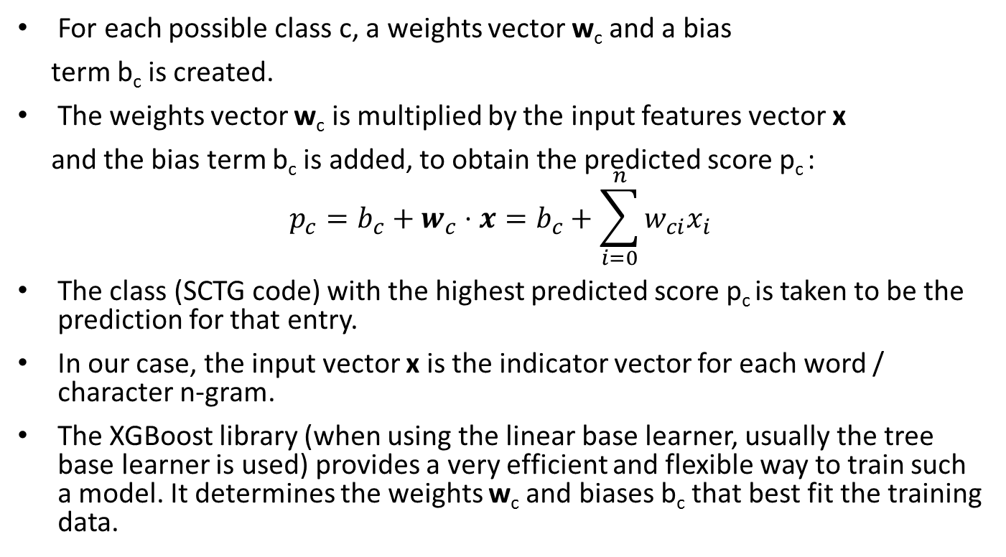
XGBoost Model with Linear Base Learners
For each possible class c, a weights vector w_{c} and a bias
term b_{c} is created.
The weights vector w_{c} is multiplied by the input features vector x
and the bias term b_{c} is added, to obtain the predicted score p_{c} :
$$p_{c}=b_{c}+w_{c}⋅x=b_{c}+\sum_{i=0}^{n}{w_{ci}x_{i}}$$
The class (SCTG code) with the highest predicted score p_{c} is taken to be the prediction for that entry.
In our case, the input vector x is the indicator vector for each word / character n-gram.
The XGBoost library (when using the linear base learner, usually the tree base learner is used) provides a very efficient and flexible way to train such a model. It determines the weights w_{c} and biases b_{c} that best fit the training data.

Slide 28
An Example
Suppose we have the n-grams “choco”, “milk”, “milk choco”, and “ate milk”.
We have some labelled data, with classes for Milk and Chocolate.
Document term matrix:
Text | “choco” | “milk” | “milk choco” | “ate milk” | Label
Super Chocolates | 1 | 0 | 0 | 0 | Chocolate
Jug of Milk | 0 | 1 | 0 | 0 | Milk
Milk Chocolate | 1 | 1 | 1 | 0 | Chocolate
Chocolate Milk | 1 | 1 | 0 | 1 | Milk

Slide 29
An Example
We can use the following weights (set bias to zero):
“choco”: +1 for chocolate, 0 for milk.
“milk”: 0 for chocolate, +1 for milk.
“milk choco”: +2 for chocolate, -2 for milk.
“ate milk”: -2 for chocolate, +2 for milk.
The prediction result for each product becomes:
Text | Chocolate Class | Milk Class | Predicted Class
Super Chocolates | 1 | 0 | Chocolate
Jug of Milk | 0 | 1 | Milk
Milk Chocolate | 1 + 2 = 3 | 1 + (-2) = -1 | Chocolate
Chocolate Milk | 1 + (-2) = -1 | 1 + 2 = 3 | Milk

Slide 30
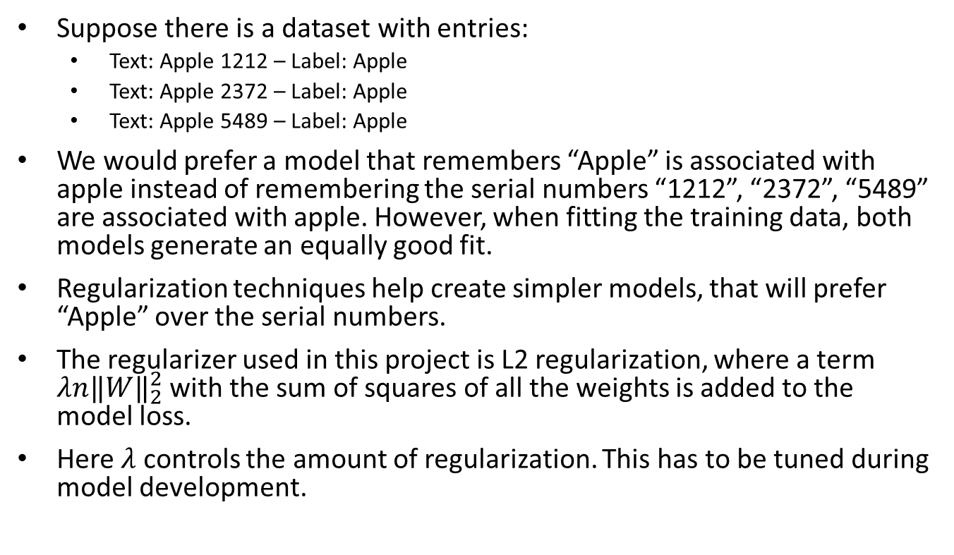
Regularization
Suppose there is a dataset with entries:
Text: Apple 1212 – Label: Apple
Text: Apple 2372 – Label: Apple
Text: Apple 5489 – Label: Apple
We would prefer a model that remembers “Apple” is associated with apple instead of remembering the serial numbers “1212”, “2372”, “5489” are associated with apple. However, when fitting the training data, both models generate an equally good fit.
Regularization techniques help create simpler models, that will prefer “Apple” over the serial numbers.
The regularizer used in this project is L2 regularization, where a term $λn{‖W‖}_{2}^{2}$ with the sum of squares of all the weights is added to the model loss.
Here $λ$ controls the amount of regularization. This has to be tuned during model development.

Slide 31
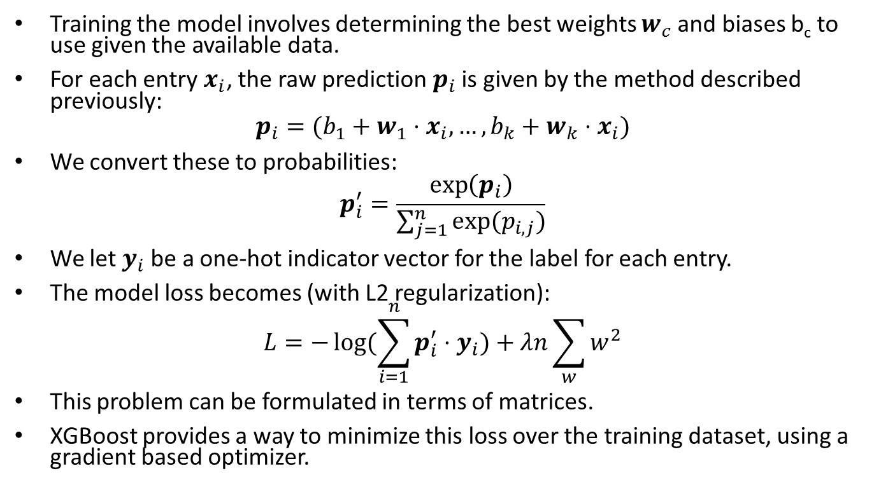
Training the Model
Training the model involves determining the best weights $w_{c}$ and biases b_{c} to use given the available data.
For each entry $x_{i}$, the raw prediction $p_{i}$ is given by the method described previously:
$$p_{i}=(b_{1}+w_{1}⋅x_{i},…,b_{k}+w_{k}⋅x_{i})$$
We convert these to probabilities:
$$p_{i}^{′}=\frac{\exp\left(p_{i}\right)}{\sum_{j=1}^{n}{exp⁡(p_{i,j})}}$$
We let $y_{i}$ be a one-hot indicator vector for the label for each entry.
The model loss becomes (with L2 regularization):
$$L=−\log{(\sum_{i=1}^{n}{p_{i}^{′}⋅y_{i})}}+λn\sum_{w}{w^{2}}$$
This problem can be formulated in terms of matrices.
XGBoost provides a way to minimize this loss over the training dataset, using a gradient based optimizer.

Slide 32
Fixing the Dataset
When this was originally tried several months ago with the original data, the accuracy obtained was in the 70%-75% range after some tuning.
We investigated the source of the errors, to help us determine the solution. We found that many products appeared to be coded inconsistently.
A file was prepared containing all entries, highlighting entries were the machine learning predicted code (generated in a 3-fold cross validation run) differed from the original code.
Subject matter experts went over this file, focusing on such discrepancies, entries similar to found problematic ones, and any other anomalous entries they encountered.

Slide 33
Fixing the Dataset
In total the following edits were made (out of 190664 entries from reference dataset, company dataset, or manually added):
13298 discrepancies were changed to the machine learning prediction.
12107 discrepancies were kept with the original code.
13925 entries (mixture of discrepancies and non-discrepancies) were changed to a custom code.
The classification accuracy steadily increased as fixes were made.

Slide 34
Results Obtained
The following results hyperparameters are used:
Minimum count of vocabulary terms: 2
Iterations: 250
Learning rate: 0.005
Lambda (L2 regularization): 10⁻⁵
With 5-fold cross validation, the test set accuracies obtained were: 90.96%, 91.27%, 90.73%, 91.36%, 90.59%. These are consistently around 91%.
When entries very similar to company training data are removed from the test set (same after spaces and punctuation removed), the accuracies for each fold decreased to: 88.75%, 89.08%, 88.52%, 89.21%, 88.27%. Overall accuracy in this case is in the 88% - 89% range.
Per-class accuracy results are available, which reveal good accuracy scores (based on F-measure and other scores) for most classes, except some with little data available.

Slide 35
Hyperparameters Used
The following hyperparameters are used for the character n-grams model and XGBoost:
Character n-grams length: 3 to 6
Minimum document count (in training set) for term to be included in vocabulary: 2
Iterations for XGBoost: 250
Learning rate (how much should XGBoost update model in each iteration): 0.005
Lambda (L2 regularization): 10⁻⁵
The following string preprocessing is performed:
One version of the string has non-ASCII characters replaced by ASCII and all punctuation sequences replaced by a single space.
Another version is the same as above, except all spaces are then removed.
Both versions are concatenated in the format: “ @ string_ver1 @ string_ver2 @ ”.

Slide 36
Going into Production
We are currently in the process of transitioning this into production.
The new version of G-Code will have support for invoking machine learning models for prediction including the XGBoost classifier used here.
G-Code will be integrated into the Common Coding Environment (CCE) that is under development.
The G-Code and CCE integration will make it much simpler to put new machine learning models into production and will allow teams to leverage the benefits of both.
A Quality Assurance framework developed for retailer scanner data NAPCS classification will be used here.

Slide 37
Transfer to New Companies
We have good results for the current company. The next step is to extend this to additional companies.
There are four other companies for which this data is already available, and in the future there will be many more.
We will start with one of those four companies and proceed from there. How much work is required depends on how similar the products descriptions for the new company are to the existing product descriptions.

Slide 38
Additional Opportunities
Data from new companies will help provide additional examples for rare SCTG codes with few existing examples.
A program has been created to automatically add abbreviations, short forms, spelling errors, stemming / “unstemming”, etc. to the training set.
Another program has also been developed to detect anomalies in text data (new words, terms, etc.) that can help in detecting new types of products that may need to be fixed and added to the training set.

Slide 39



THANK YOU!
For more information, please visit
www.statcan.gc.ca
MERCI! Pour de plus amples renseignements,
visitez le
www.statcan.gc.ca
#StatCan100

